Slide 1
Programming II
(C Programming Language)
C Variables, C Constants and Literals
Lecture 4, Wednesday February 03, 2021
Dr. Ayman ALJARBOUH

Slide 2
Outline
C Variables
C Constants
C Literals

Slide 3

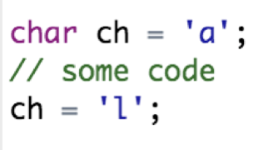
C Variables
A variable is a named location used to store data in the memory
It is placeholder to hold any type of data which the program can use to assign and modify during the course of execution
To indicate the storage area, each variable should be given a unique name (identifier)
Variable names are just the symbolic representation of a memory location. For example:
Note that, the value of a variable can be changed during the program execution. For example:

Slide 4
Rules for Naming a Variable
A variable name can have letters (uppercase and lowercase letters), digits and underscore
Variable names are case-sensitive: computer and Computer are different variables
Variable should not start with a number
C Keywords are not allowed as variable names
There is no rule on how long a variable name (identifier) can be. However, you may run into problems in some compilers if the variable name is longer than 31 characters

Slide 5
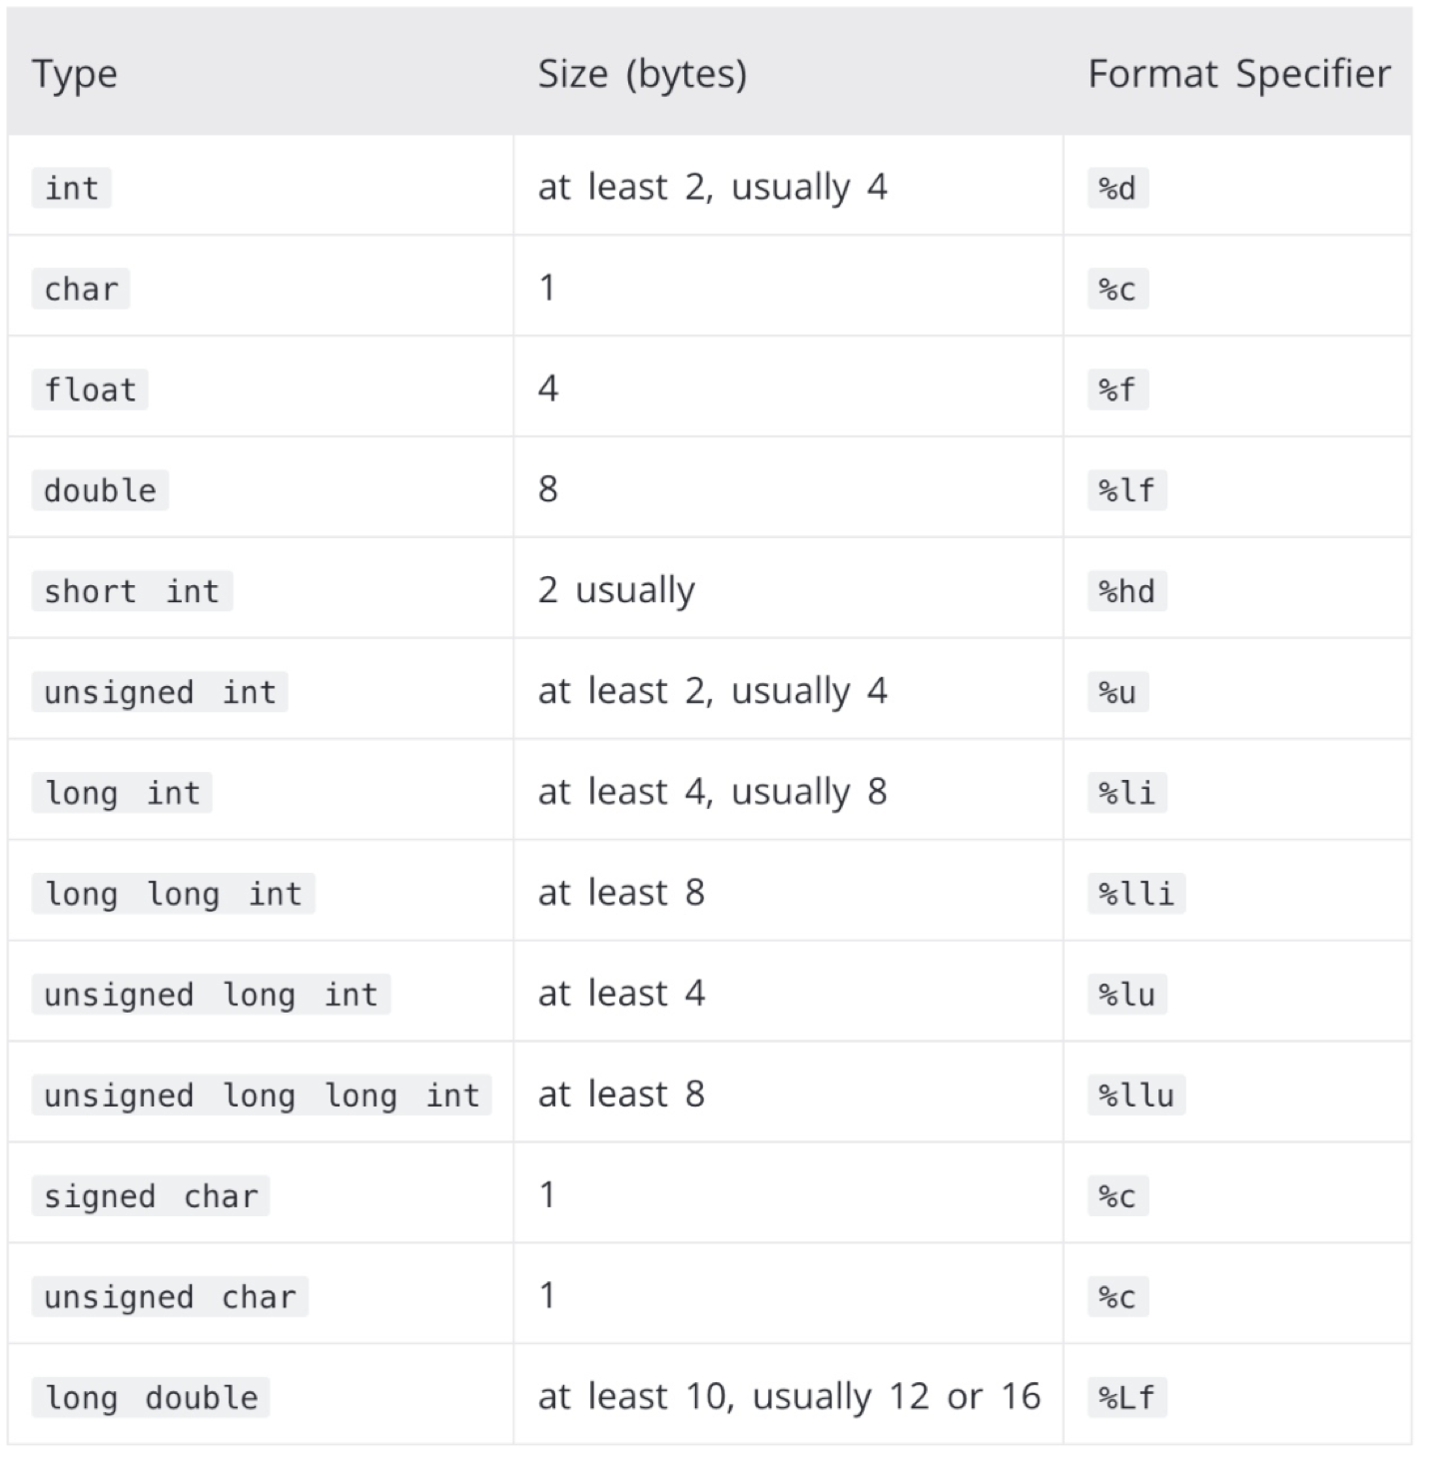
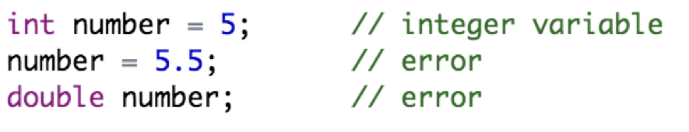
Types of Variables
C is a strongly typed language. The variable type cannot be changed once it is declared
Here, the type of number variable is int. You cannot assign a floating-point (decimal) value 5.5 to this variable. Also, you cannot redefine the data type of the variable to double.

Slide 6

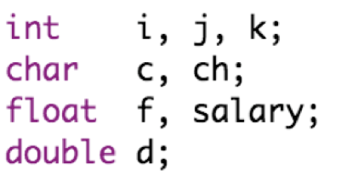
Variable Definition in C
A variable definition specifies a data type and contains a list of one or more variables of that type as follows:
Here, type must be a valid C data type, and variable_list may consist of one or more identifier names separated by commas
Some valid declarations are:

Slide 7

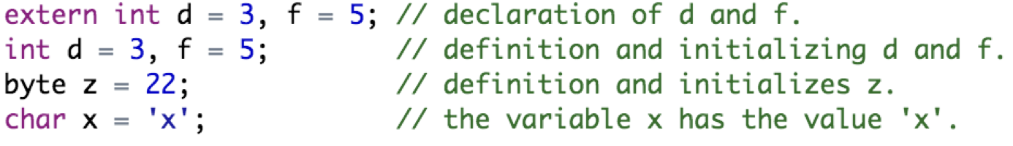
Variable Definition in C
Variables can be initialized (assigned an initial value) in their declaration
The initializer consists of an equal sign followed by a constant expression as follows:
Some valid declarations are:

Slide 8
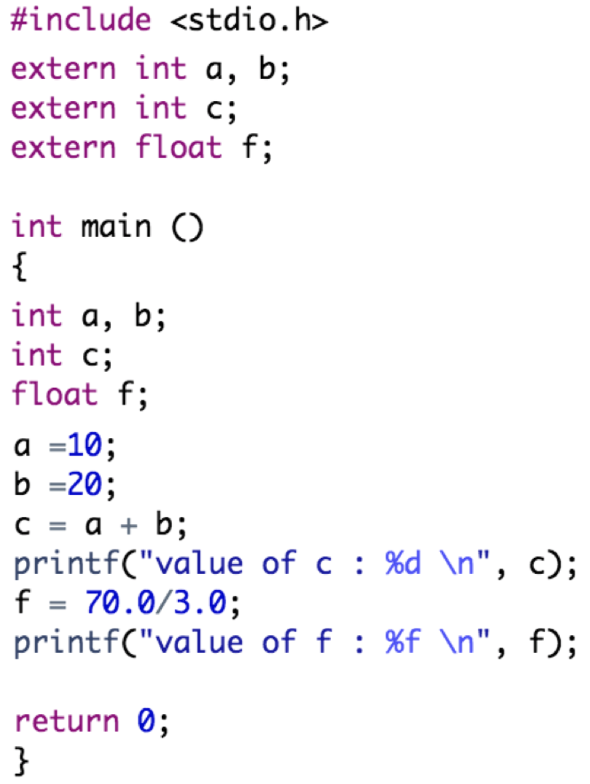
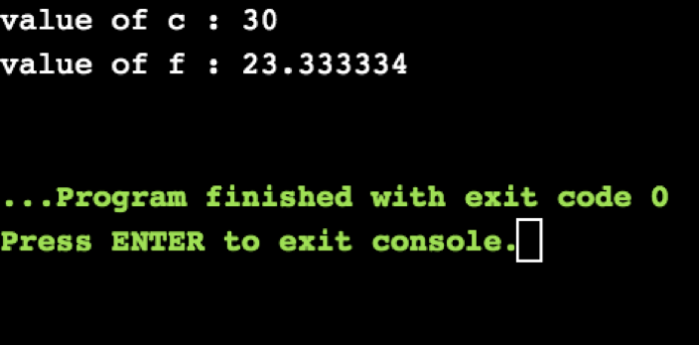
Variable Declaration in C
Output:
Example:

Slide 9


Lvalues and Rvalues in C
There are two kinds of expressions in C:
lvalue: An expression that is an lvalue may appear as either the left-hand or right-hand side of an assignment
rvalue: An expression that is an rvalue appears on the right- but not left-hand side of an assignment
Variables are lvalues and so may appear on the left-hand side of an assignment. Numeric literals are rvalues and so may not be assigned and cannot appear on the left-hand side
Following is a valid statement:
Following is not a valid statement:

Slide 10
Outline
C Variables
C Constants
C Literals

Slide 11

C Constants
A constant is a type of variable whose value cannot be changed
Usually, we use capital letters where possible to declare a constant. That is, it is a good programming practice to define constants in CAPITALS
There are two simple ways in C to define constants:
Using #define pre-processor
Using const keyword

Slide 12
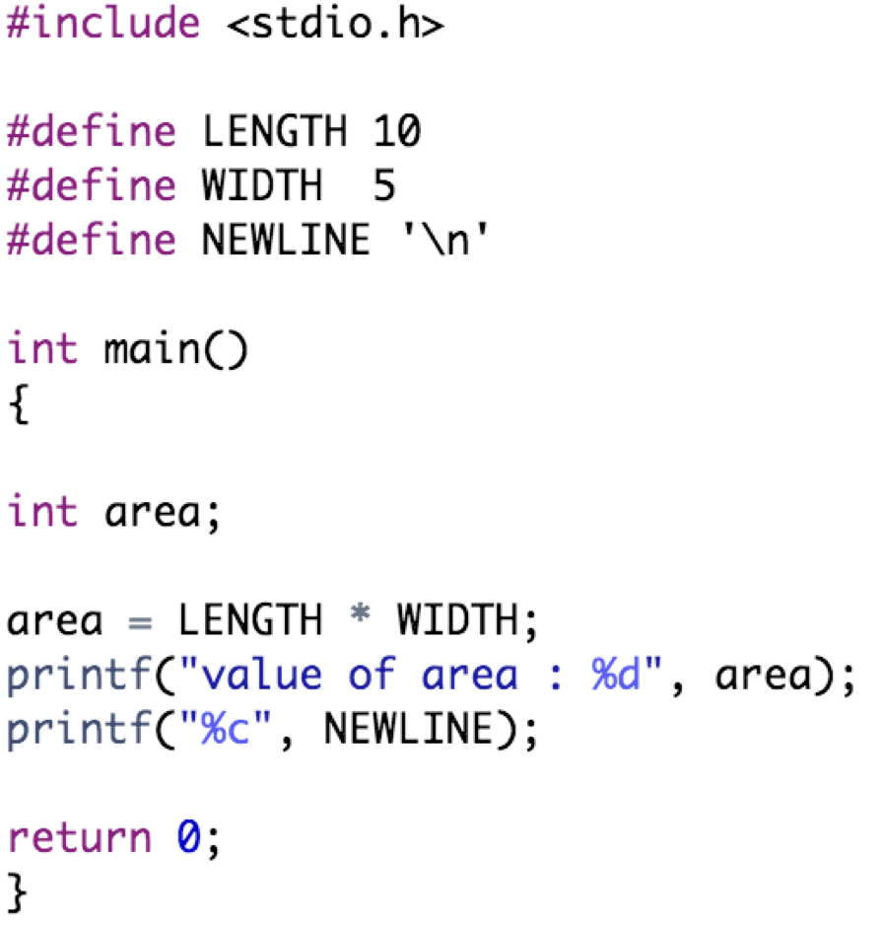
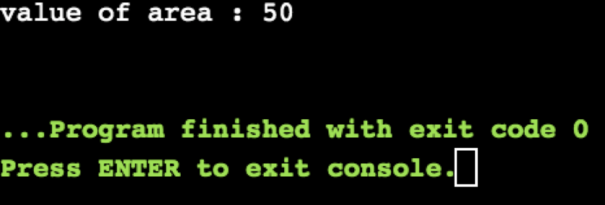
C Constants
Output:
Example:

Slide 13
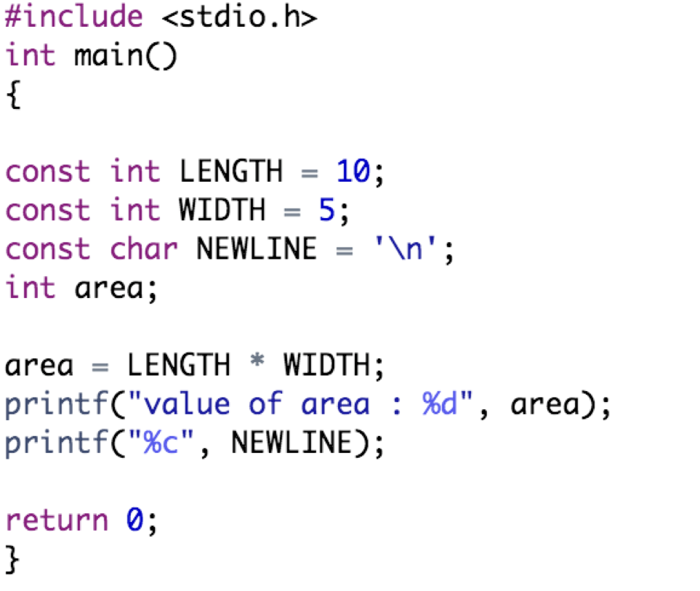
C Constants
Output:
Example:

Slide 14
Outline
C Variables
C Constants
C Literals

Slide 15
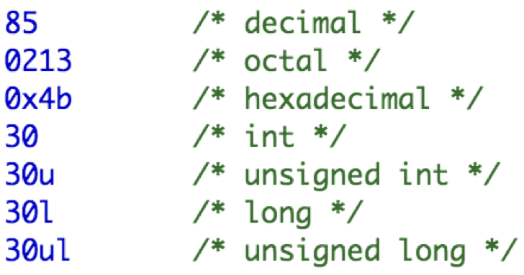
C Literals
An integer literal can be a decimal, octal, or hexadecimal constant. A prefix specifies the base or radix: 0x or 0X for hexadecimal, 0 for octal, and nothing for decimal
An integer literal can also have a suffix that is a combination of U and L, for unsigned and long, respectively
The suffix can be uppercase or lowercase and can be in any order

Slide 16
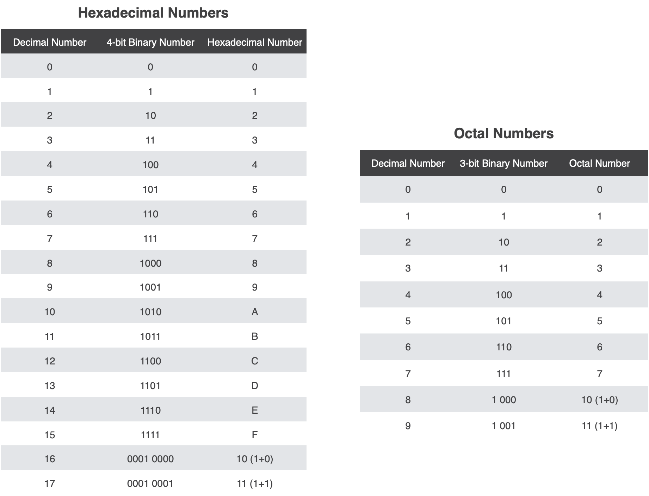

Slide 17
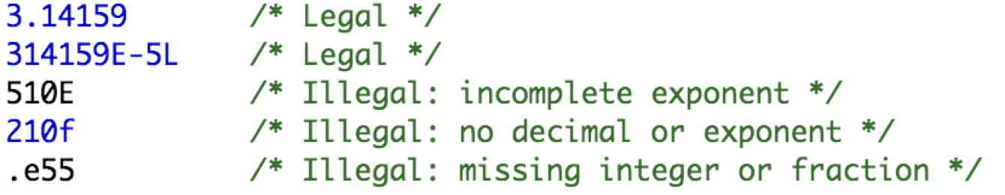
Floating-Point Literals
A floating-point literal has an integer part, a decimal point, a fractional part, and an exponent part
You can represent floating point literals either in decimal form or exponential form
The signed exponent is introduced by e or E

Slide 18
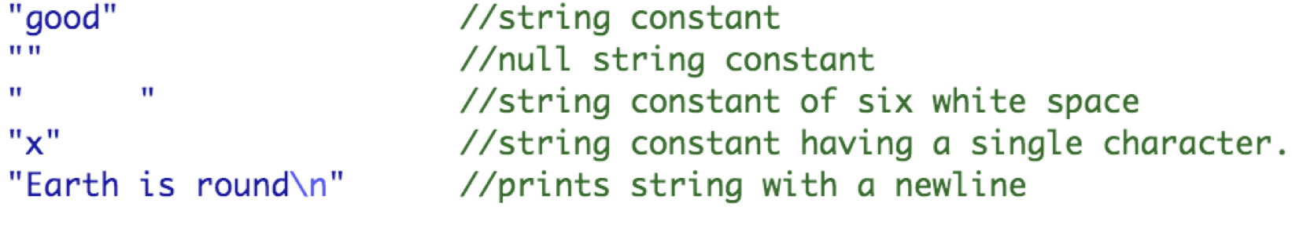
String Literals
String literals are enclosed in double quotes "”
A string contains characters that are similar to character literals: plain characters, escape sequences, and universal characters
You can break a long line into multiple lines using string literals and separating them using whitespaces

Slide 19
Practical Exercises
Write and Compile the following C programs:
Program 1:

Slide 20
Practical Exercises
Write and Compile the following C programs:
Program 2:

Slide 21
Practical Exercises
Write and Compile the following C programs:
Program 3:

